Slide 1

Airtraffic system UML Colloquium
Presented by Team 1
Atanasova, Antoniya - 03648938
Lee, Alice - 03281160
Petrov, Ivan - 03648235
Rudert, Katherina - 03648166
Murugesh, Rishigesh - 03636607
Streitweiser, Benedikt - 03623651

Slide 2
Agenda
UML data model overview
UML workflow – Booking a flight
Sequence diagrams

Slide 3

UML data model class diagram
Migration process included
Identifying the core entities and reducing their number up to 17
Migrating the ERM model into UML class diagram with the entities from step1
Class diagram overview

Slide 4
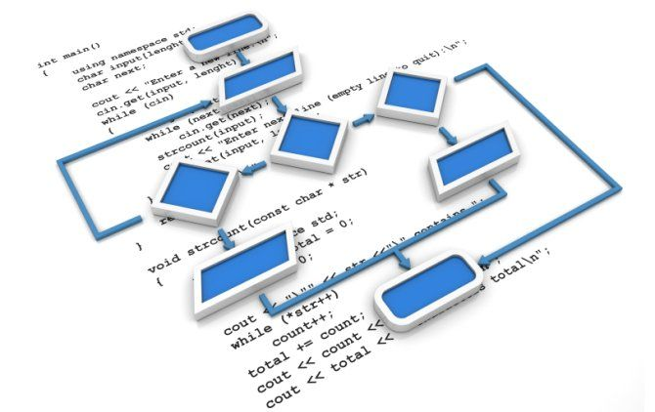
UML workflow diagram
Workflow scope – Booking a flight through air traffic database management system
Activity diagram overview

Slide 5
UML sequence diagrams
Passenger
Airport
Airline
Sequence diagrams overview

Slide 6

Thank You!

